Slide 1










GREEN BITE
Sahar Alkhadouri
Fatima AL-Amri
Maryam AL-Aamri

Slide 2



REQUIREMENTS SPECIFICATION
GreenBite is a vegetarian dine-in restaurant that needs a system to manage data related to its staff, customers, tables, orders, bills, and menu items. Each staff member has a unique ID, name, position, contact number, email, hire date, salary, gender, and status, and they are responsible for serving tables and taking customer orders. Customers also have a unique customer ID, name, email, phone number, gender, and membership level. Inside the restaurant, every table has a table ID, number of guests, serving time, and the staff member assigned to serve it. Customers seated at a table can place orders, and each order includes an order ID, order timestamp, payment method, payment status, order status, and any special notes. An order is placed by one customer and taken by one staff member, although each customer may place multiple orders and each staff member can serve many customers. Orders consist of multiple vegetarian menu items, and each menu item—identified by item ID, name, category, calories, description, and price—can appear in many different orders. These details are stored in the order-item list, where the system tracks the quantity of each item ordered. After finishing their meal, the system generates a bill for the customer, recording the bill ID, order ID, bill date, and total amount. Each order has exactly one bill, and the bill reflects all vegetarian items included in the order.

Slide 3

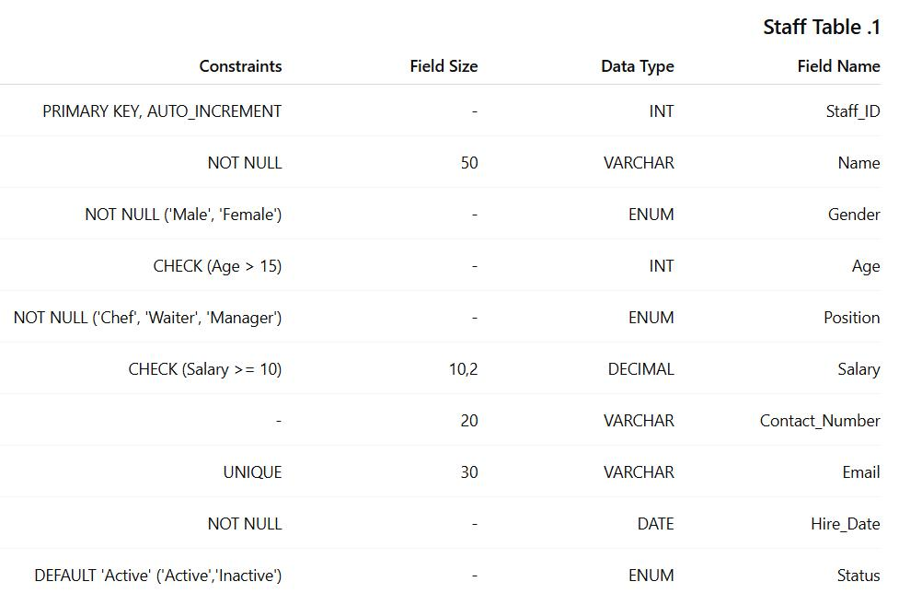

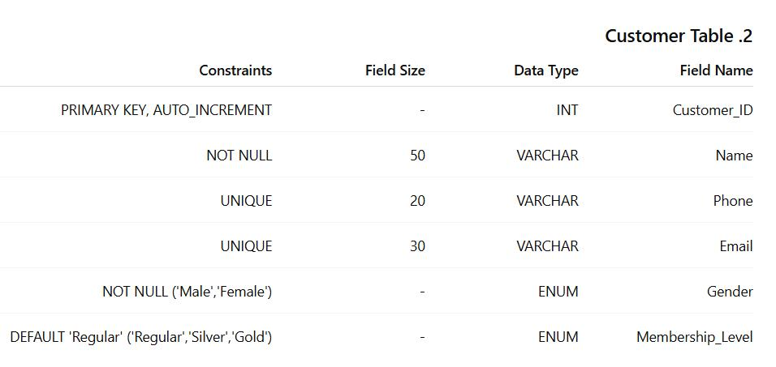

Slide 4
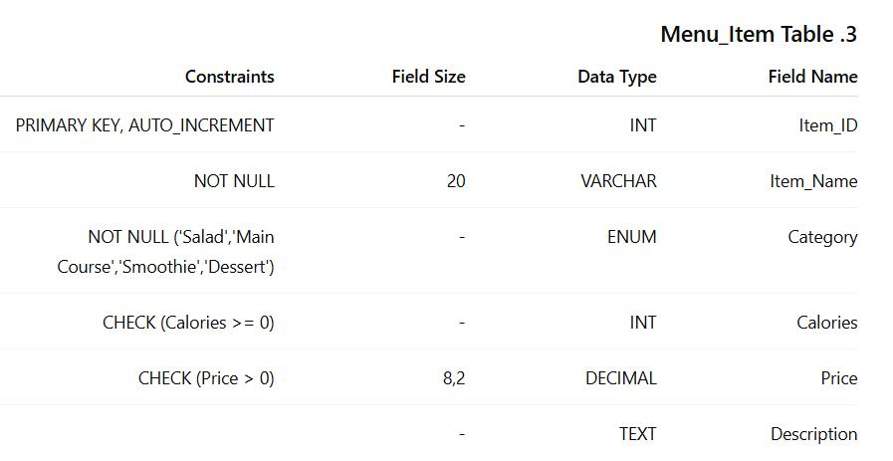

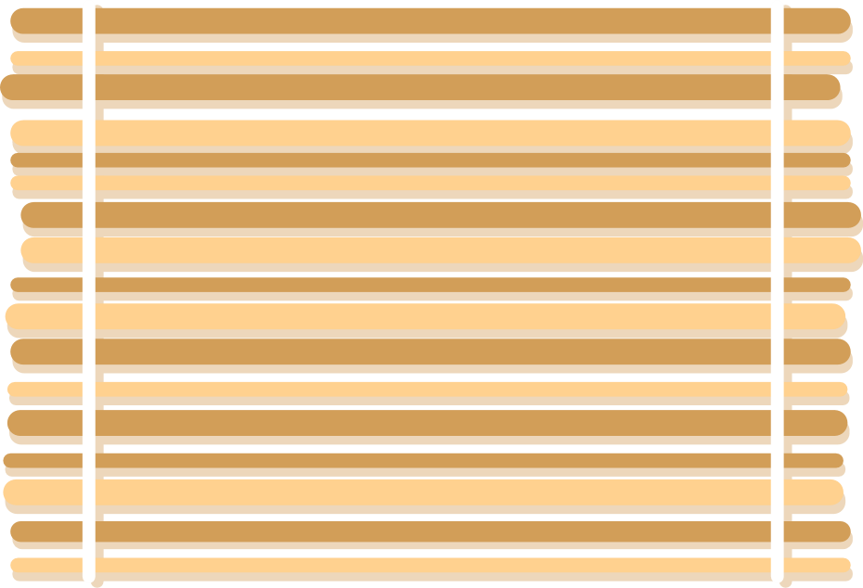
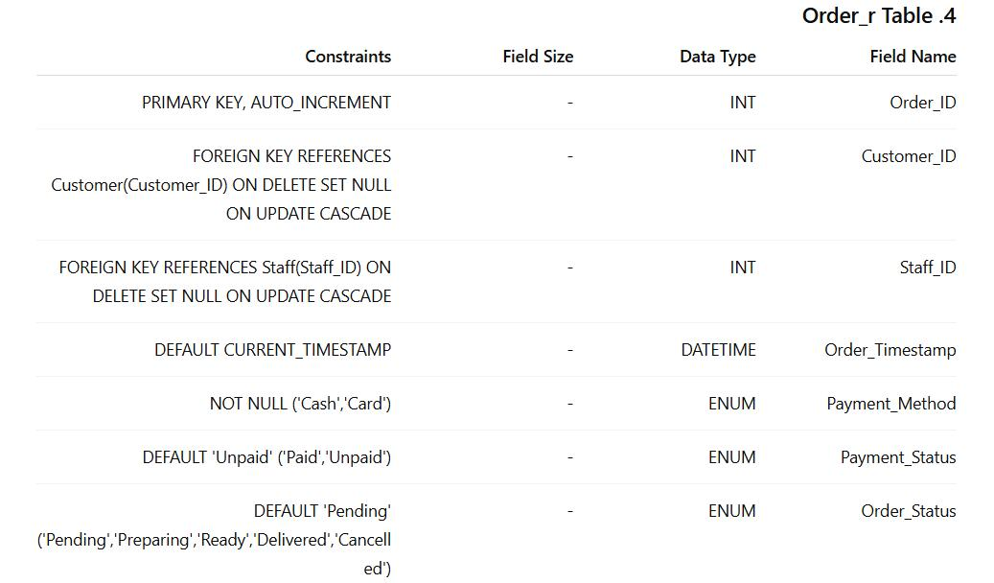


Slide 5

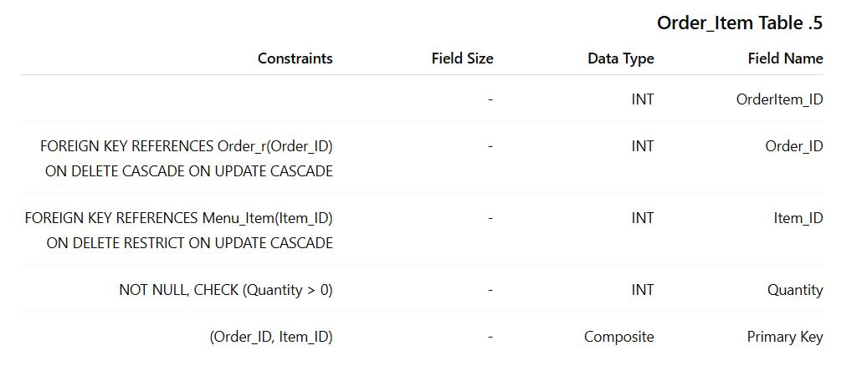

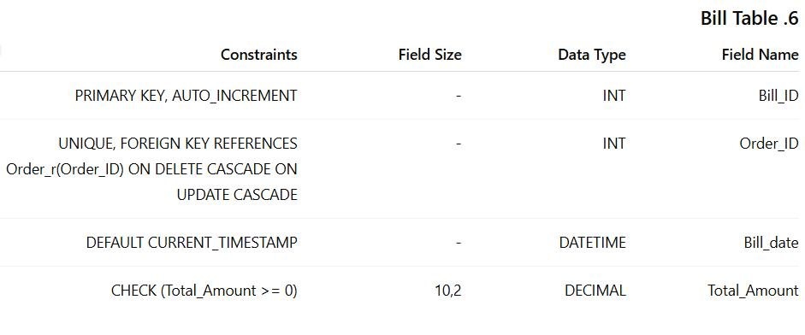


Slide 6

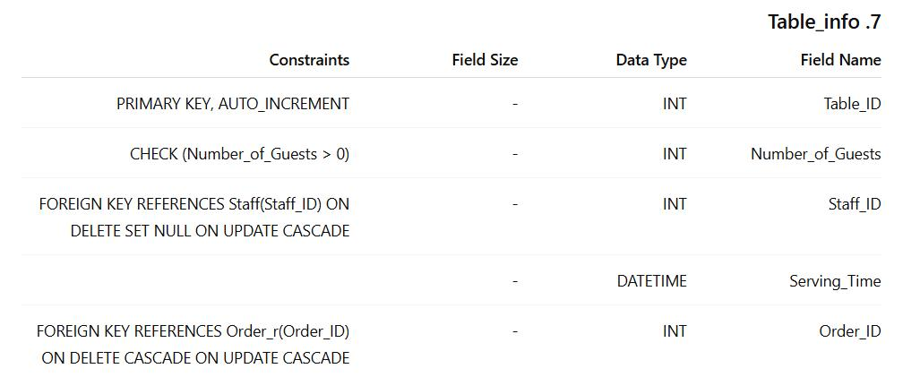


Slide 7
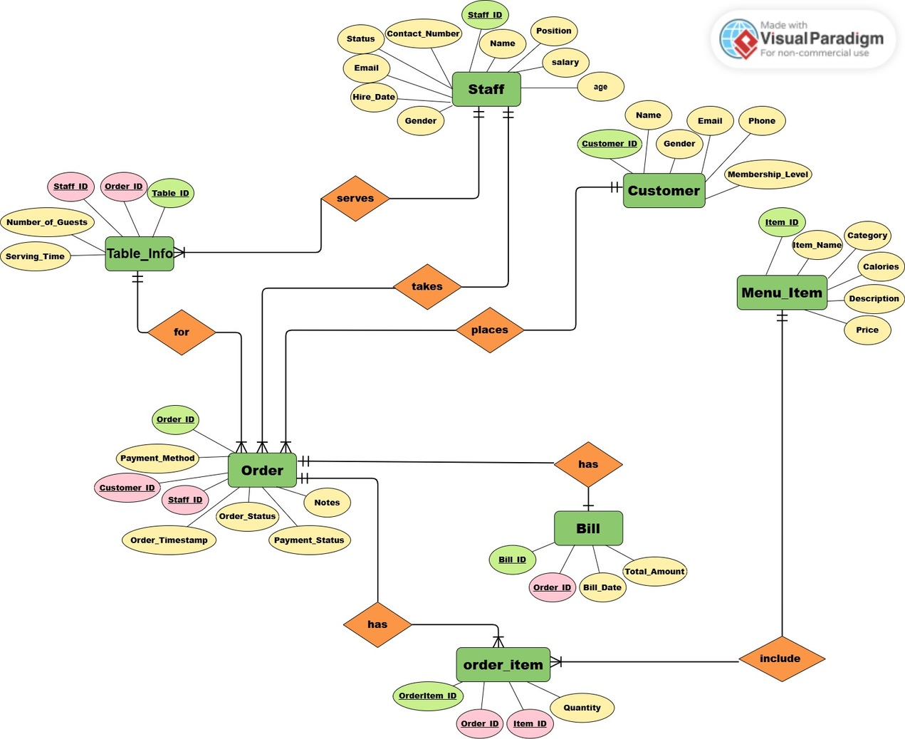
CONCEPTUAL ER DIAGRAM(ERD)

Slide 8


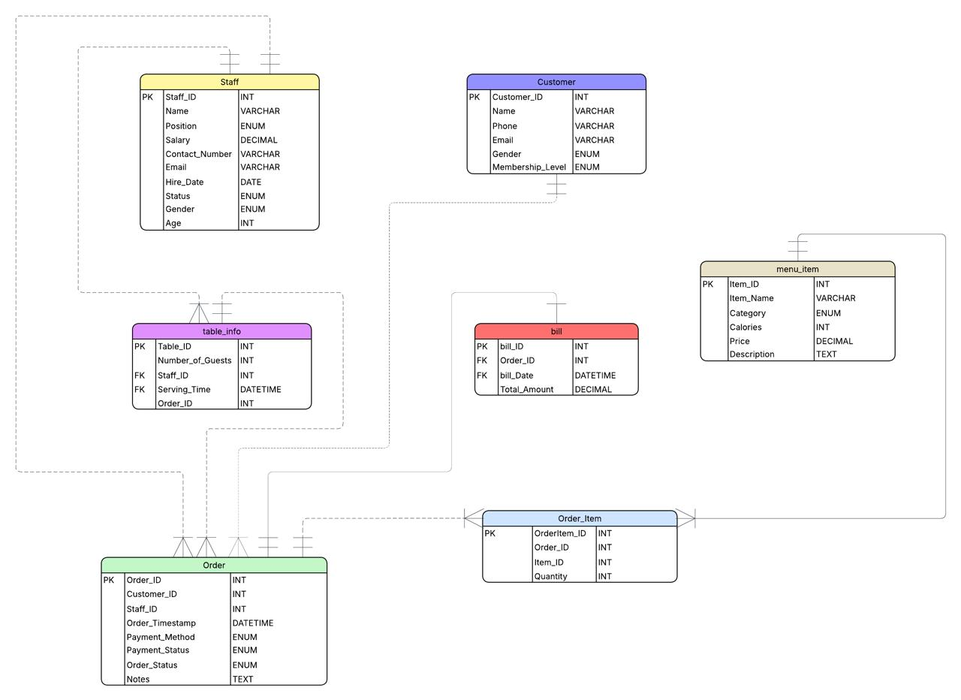
LOGICAL ER DIAGRAM(ERD)

Slide 9
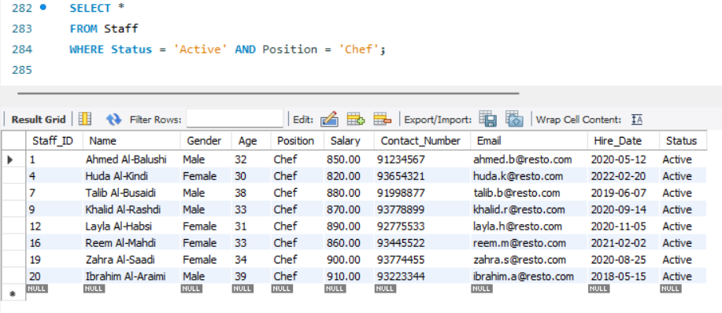
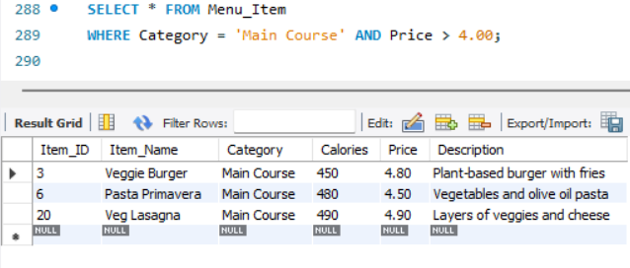
Get all active staff who are Chefs
Get all menu items that are Main Course and cost more than 4 OMR

Slide 10
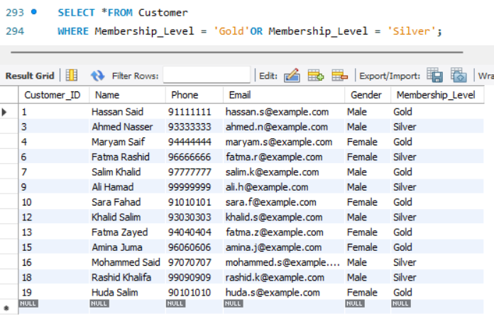
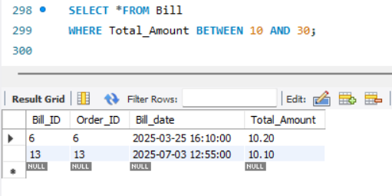
Get all customers who are Gold OR Silver members
Get all bills where the total amount is between 10 and 30 OMR

Slide 11
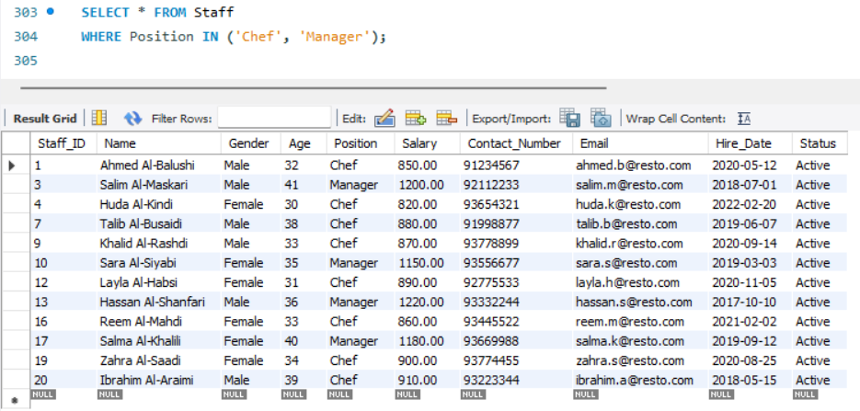
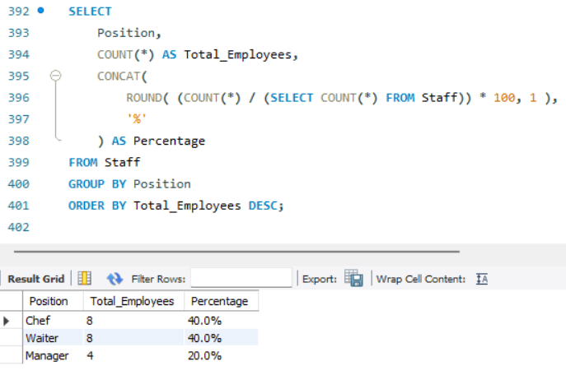
Get staff who have positions in this list ('Chef', 'Manager')
Calculate the number and percentage of staff in each job position

Slide 12
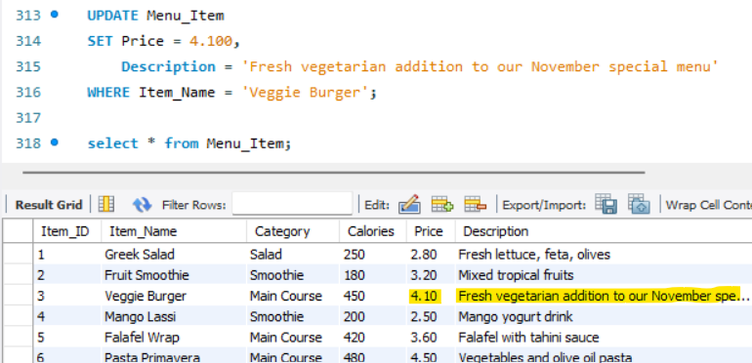
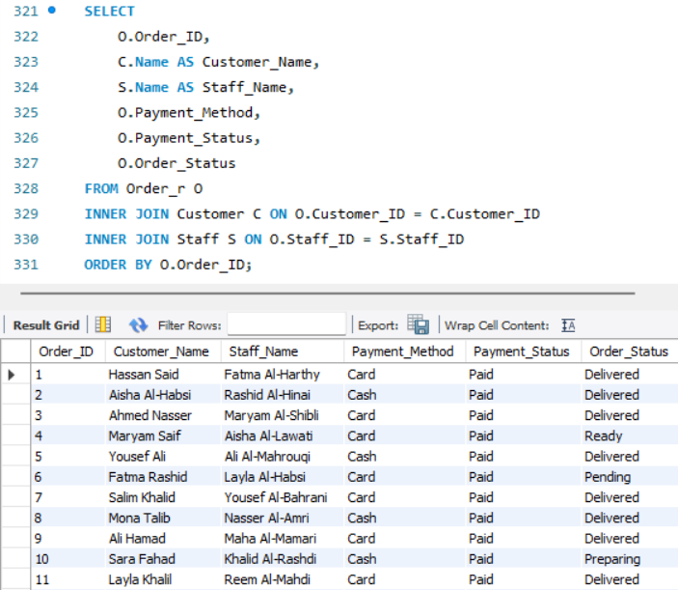
Update menu item 'Veggie Burger' (new price and description)
Show orders with customer and staff names (INNER JOIN)

Slide 13
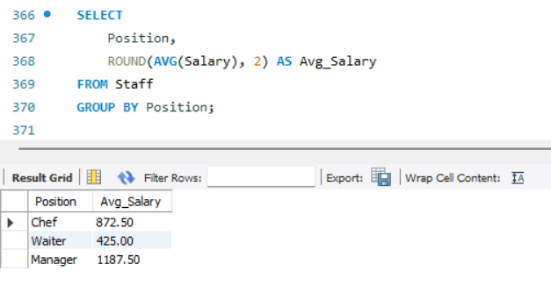
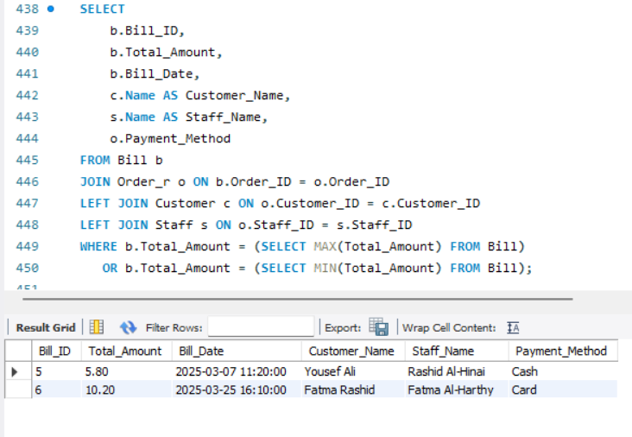
Average salary by position
MAX and MIN total amount in bills(info)

Slide 14
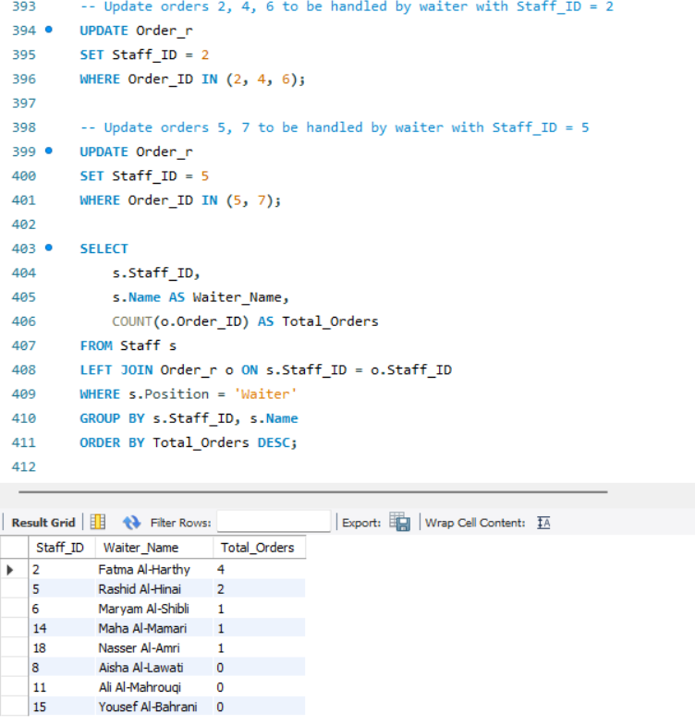
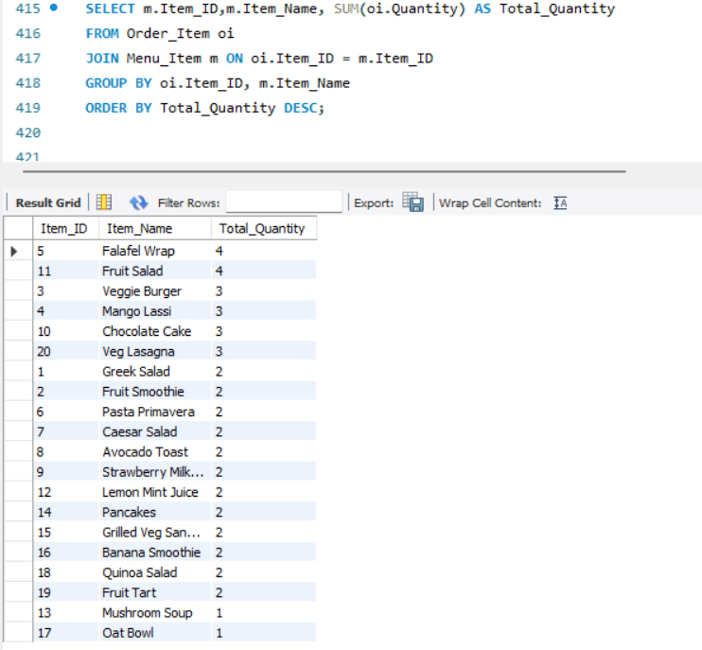
Which waiter has the most orders (only Position = 'Waiter')
Count each menu item and sum the total quantity ordered

Slide 15
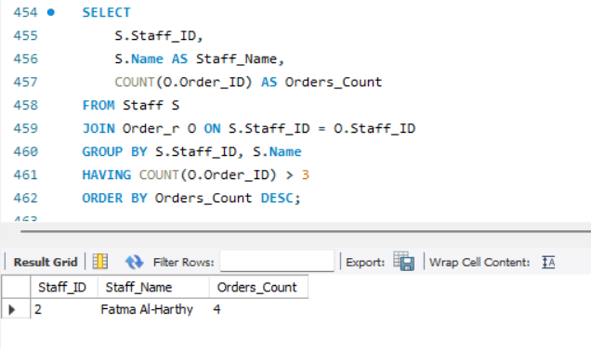
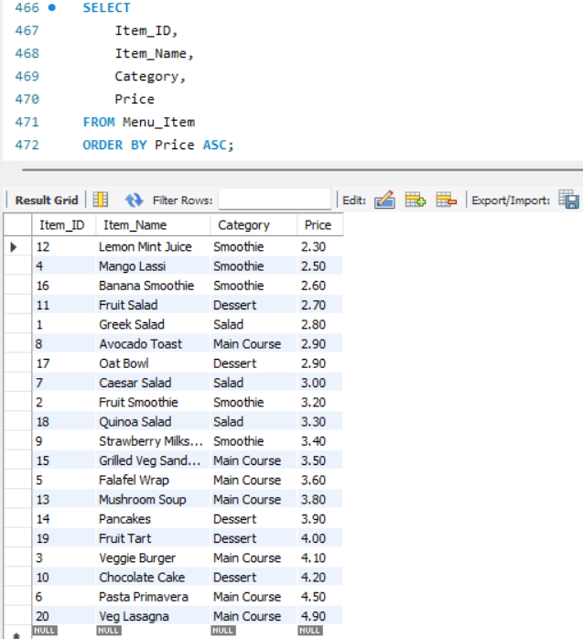
Orders count per staff, only staff with more than 3 orders (using HAVING)
Menu items sorted by price (ascending)

Slide 16
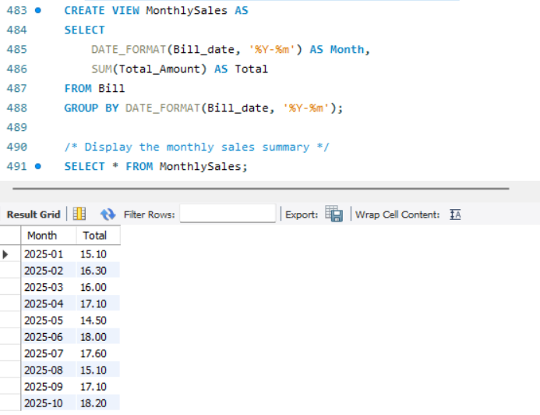
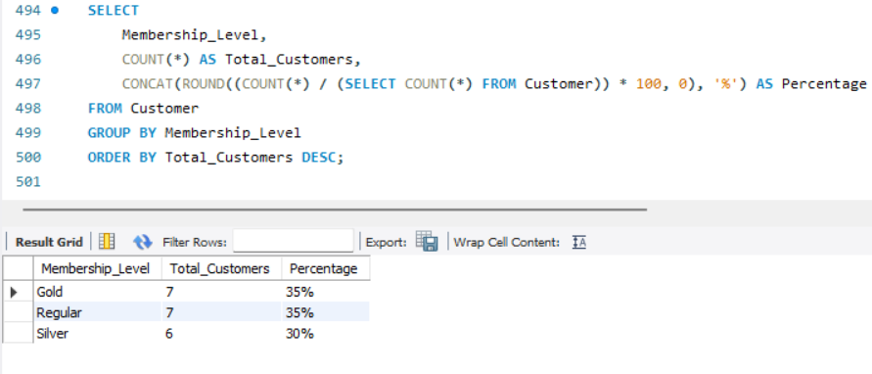
Create a view that shows the total sales for each month
Compare membership levels by showing the count and percentage of customers in each level

Slide 17
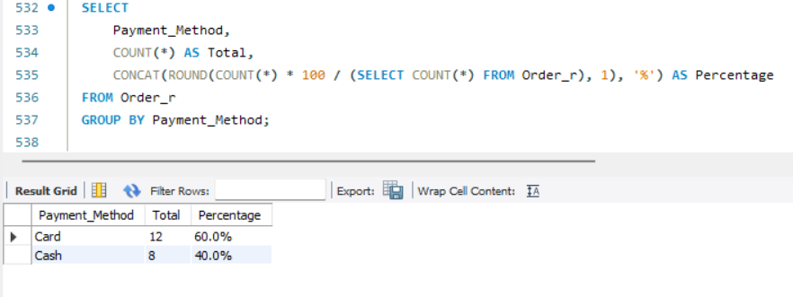
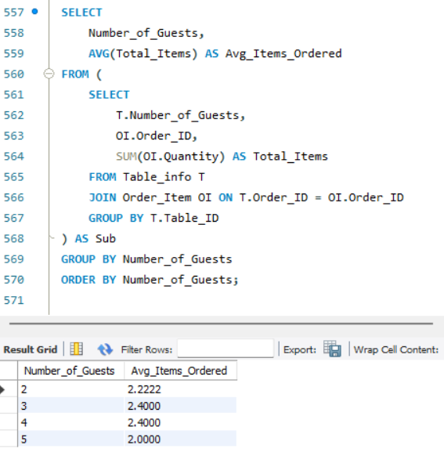
Calculate how many orders were paid using each payment method, and show the percentage
Find the relationship between the number of guests at a table and the average number of items ordered.

Slide 18
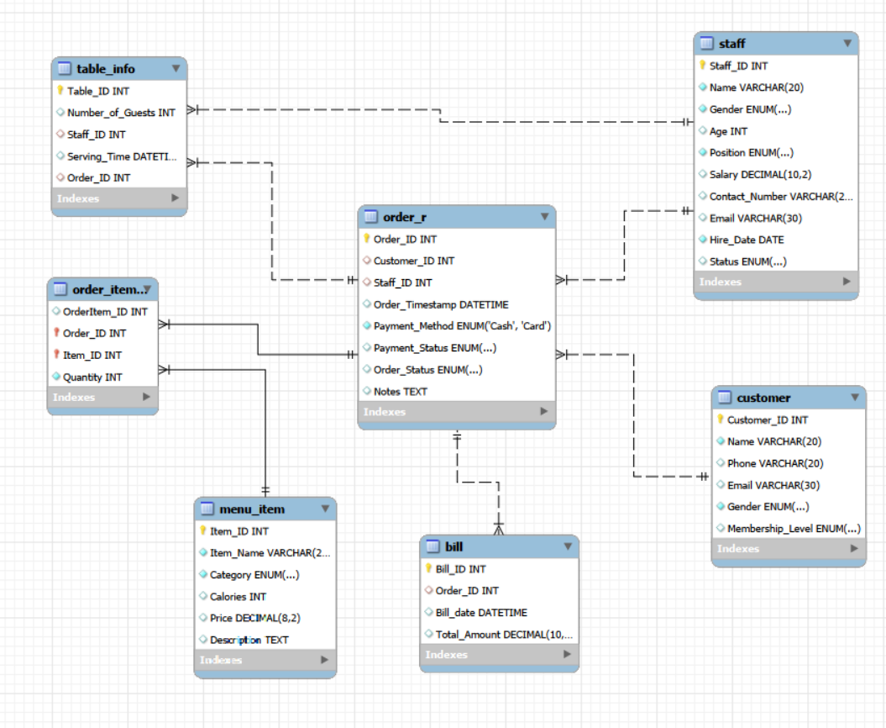
PHYSICAL ERD

Slide 19
CONCLUSION
A professional SQL-based database was designed and implemented for a vegetarian restaurant.
Analysis showed no direct relationship between the number of guests and the number of items ordered.
Card payment is the most commonly used payment method among customers.
Balanced staffing between chefs and waiters supports better service.
The project highlights the importance of databases in improving restaurant management and supporting decision-making.

